Slide 1
Thinking outside the Box
Why you should build, not buy
Dan Haywood

Slide 2

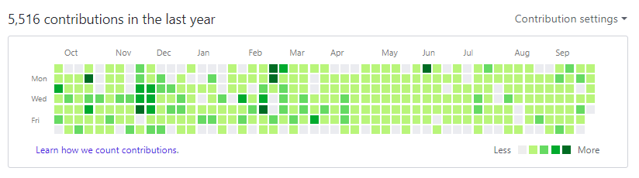
About Me
I'm an independent consultant & developer specializing in domain driven design.
I'm also an Apache Software Foundation member & committer on the Apache Isis™ framework

Slide 3
Setting the Stage

Slide 4
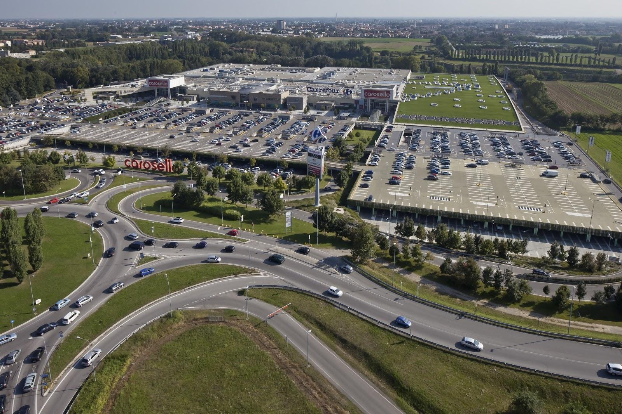
Eurocommercial Properties
33 shopping centers in France Sweden and Italy
2.7 billion Euro asset value
175 million Euro annual rental income
Notes:
Our client, Eurocommercial Properties, is one of Europe’s experienced operator of shopping malls. They operate 33 shopping centers in France Sweden and Italy with a combined value of 2.7 billion euros. The shopping centres generate an annual rental income of 175 million Euro’s
This seem big numbers but in the market ECP is relatively small company. But this allows them to operate lean and have short management lines.

Slide 5
Had bought the leading Estate Management software
Started in France
was working more or less ok
Moved ahead to Italy
where everything was Excel based
Really struggling but went into production anyway
a long backlog of issues
Notes:
Then they moved to Italy where everything was Excel based. It was what you call spreadsheet heaven.
But trying to move the flexibility of Excel into a rigid ERP like system was a real struggle.

Slide 6



TOO MANY GAPS in Italy...
Specific requirements
Law varies by country
Had bought shopping centres
Must continue to honour lease contracts from former owners
Complex domain:
Rent, service charges, entry fees, discounts, indexation
Special deals
Notes:
The main problem in Italy was that the application could not deal with their specific requirements. Some where because Law, things work differently in Italy. But also ECP had bought some new shopping centers so they had to deal with the existing lease contracts made up by the former owners.
And leasing is fairly complex. Rent, Service charges, Entry fees, Discounts, Indexation, invoicing frequencies, payment schedules. And every tenant uses his negotiation power to make a special deal. You can image that the contract of a big H&M or Apple store is very different from a little tobacco store that sits in the same building.
It was the Pareto effect in action. We got 80%. And usually it’s more likely that you accept that fact because you know that the price of striving for 100% is bay bigger than the benefits.
But in this case this was and is the essence of their business!
Q: How many of you are familiar with this side-effect of standard software?

Slide 7
Business users…

Slide 8
... and some business process they perform ...

Slide 9
... we bring in packaged software ...

Slide 10
... OF COURSE IT DOESN’T FIT ...

Slide 11
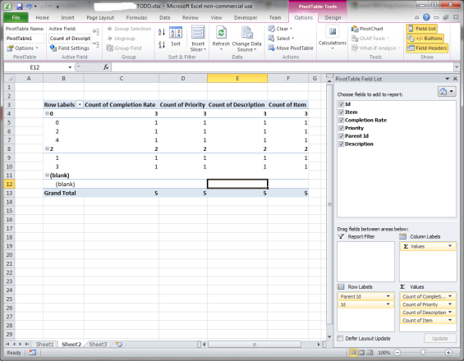
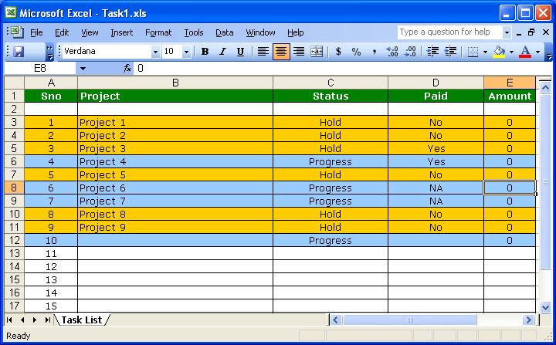
... AND users will fill the gaps, best they can

Slide 12
CORE DOMAIN

Slide 13
LET’S TRY TO IMPROVE ON THIS PICTURE

Slide 14
Accounting
Interface with Accounting
Reports and analytics
Core domain
Interface with Doc Mgmt
Document Management

Slide 15
Let me ask you …
Suppose you have a big ERP installed … how confident are you that you could upgrade easily to the next version?
It’s difficult because of dependencies:
Custom integrations from the ERP into your systems
Business process work-arounds
Adhoc automation, eg spreadsheets

Slide 16
Inverting the dependency
Own your own software – the core domain
No business process work-arounds !
No spreadsheets !
Use packaged software for supporting generic subdomains
Core domain feeds/uses the supporting subdomains
not the other way around

Slide 17
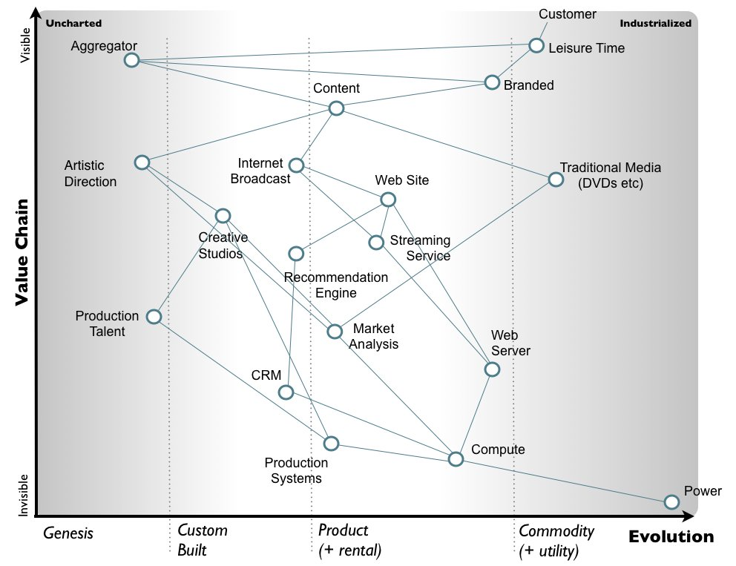
Commoditized supporting software
Supporting subdomains should be commodotized
Should be able to switch vendor
eg use Wardley Maps

Slide 18
Options

Slide 19
options
Another (better?) software vendor
Expensive to purchase / license / implement
Likely same issues as current product
Develop a bespoke system
But using what?

Slide 20

From scratch using a framework ?
Spring ?
Lots of technical layers
Scaffolding, overhead
Something else?
Focus on the domain

Slide 21
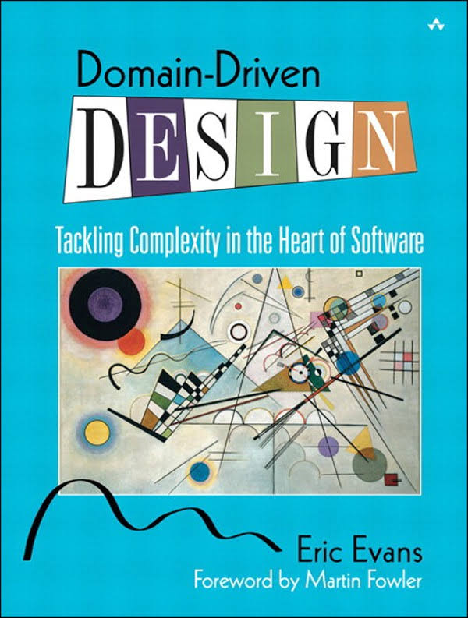

Domain Driven Design
The complexity that we should be tackling is the complexity of the domain itself ... not the technical architecture, not the user interface, not even specific features
Eric Evans

Slide 22

UBIQUITOUS LANGUAGE
“With a conscious effort by the team, the domain model can provide the backbone for that common language”

Slide 23
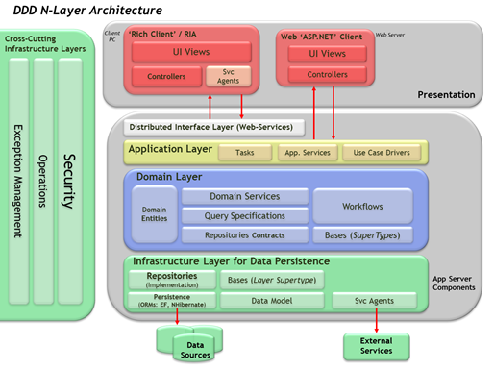
Microsoft’s domain driven architecture ?
Still too much technical complexity

Slide 24
A different tack
Build a domain-driven app …
… using the Naked Objects pattern

Slide 25
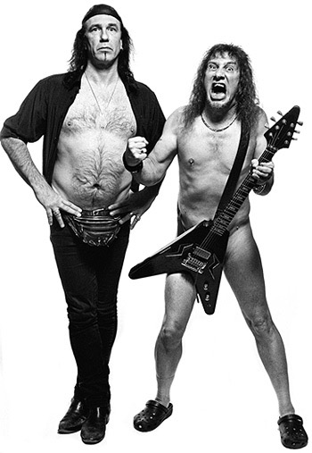
Naked What ???

Slide 26
NAKED OBJECTS

Slide 27


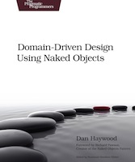
NAKED OBJECTS
An architectural pattern
A principle
Implemented by frameworks such as Apache Isis™

Slide 28
Naked Objects Pattern
Business functionality is encapsulated on the core business objects
represented in a programming language, eg Java
Objects are exposed through the UI directly & automatically
the framework automatically enforces business rules
User interactions with the system all consist of:
retrieving objects
invoking actions on them
editing their properties
Notes:
“UI for free” … UI is a fashion item anyway

Slide 29
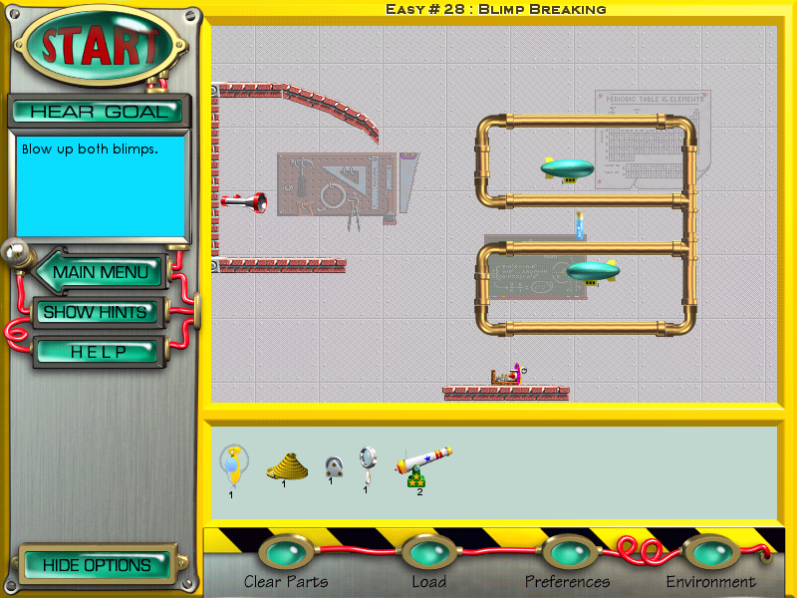
A metaphor for the system
treat the user as a problem solver, not a process follower
Notes:
Naked objects principle …
are sympathetic to the work the front-line ops people do
enables, rather than constrains
enable the executives to understand how the company is operating
so they can steer the ship effectively.

Slide 30
Process
or… how to build a naked objects app

Slide 31
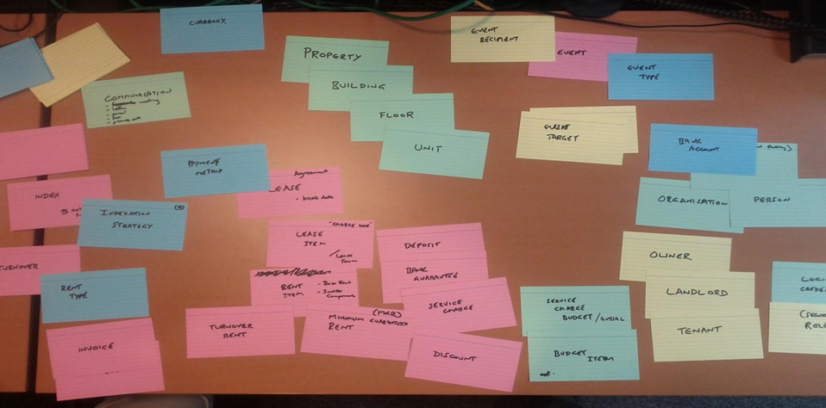
Master of your domain

Slide 32
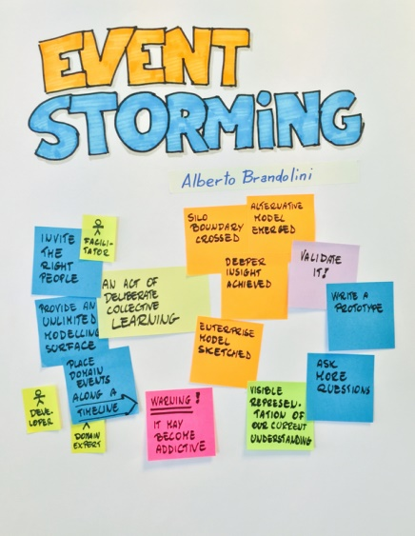
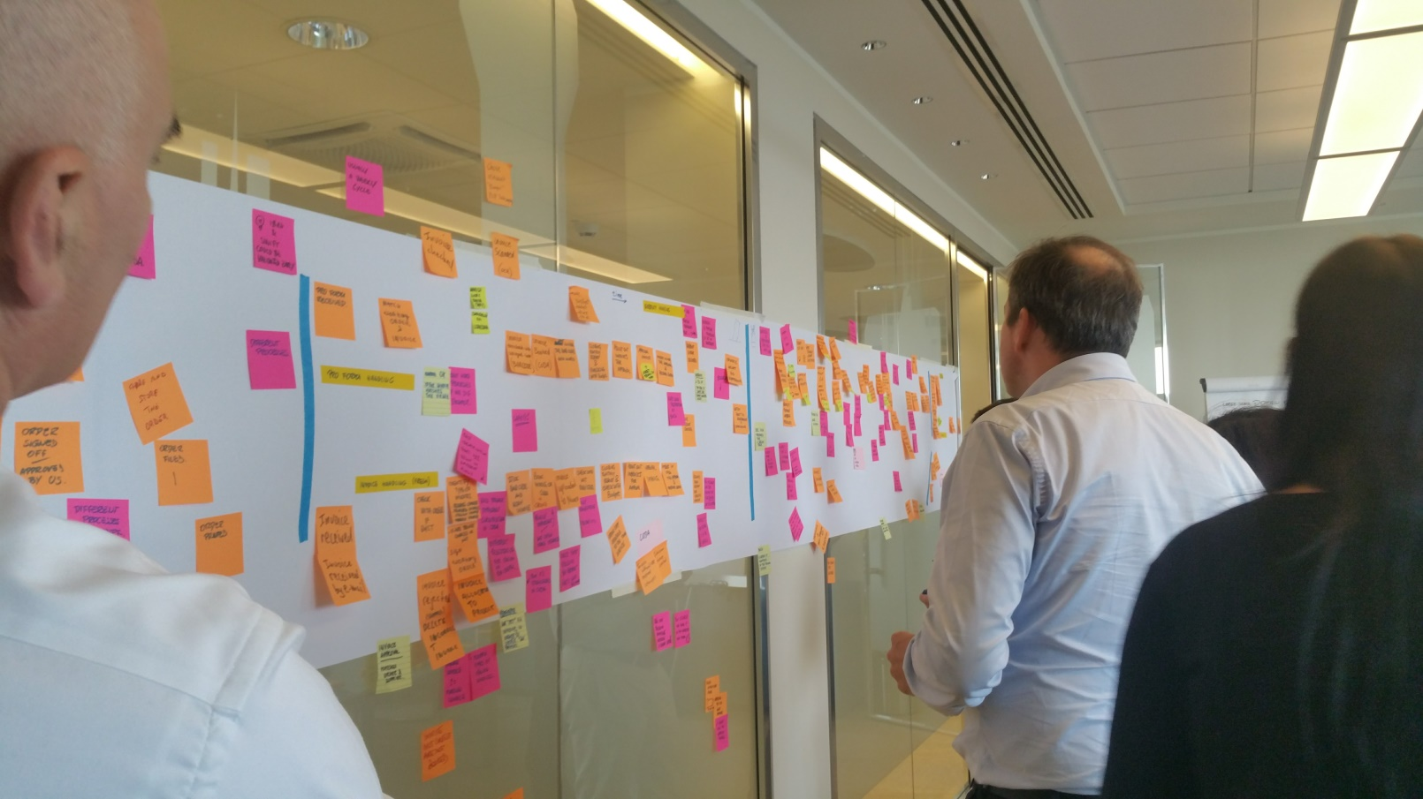
Event Storming
Get stakeholders in a room
Infinite modelling space
Identify business events that fulfil the process
Notes:
"just enough" process/context/constraints

Slide 33
Agile Development
Software development isn't a science, it's an empirical practice
we’re not trying to fly to the moon
Requires an effective feedback loop
allow both business folk and techies to find a way

Slide 34
APACHE ISIS

Slide 35
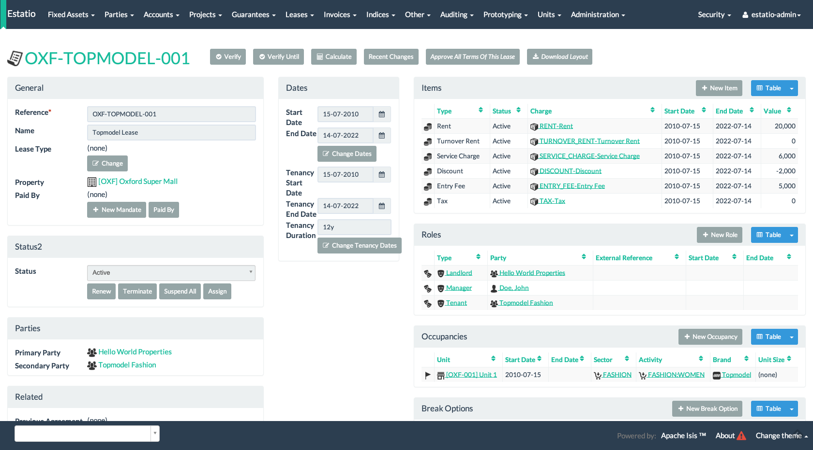
Estatio: an open source estate management app, built with apache isis

Slide 36
FEEDBACK LOOPS
Let’s take a look at how Apache Isis allows the developer to easily add new functionality [video]
And at how easy it is to update the UI layout [video]

Slide 37
LEARNINGS

Slide 38
Feedback loops ARE REALLY IMPORTANT, buT MUST BE DIRECT
No “chinese whispers”
Gathers and maintains the momentum
Key criteria when prioritizing feature backlog:
“how will we get feedback on this?”
If ignore ➔ probably will build the wrong thing
(sometimes do this deliberately to force the feedback)
Notes:
Domain expert -> business analyst …. Paper docs
Business analyst -> architect … paper docs
Architect -> developer … paper docs
Lots of mis-interpretation; takes months
Instead … the business analyst has the tools to convert his interpretation of the problem into working software, can be validated immediately.

Slide 39
CONTINUOUS Migration
Show the users “their” data
dummy data doesn’t mean anything to them
helps overcome any language barriers
needs migrating anyway, gets thoroughly tested
Divide the migration work between business and techies
Untangle those muddled & hacked-together spreadsheets
Business becomes invested in the project

Slide 40
DON’T USE CRUD
Start off with an immutable system
Rely on our ability to iterate quickly to uncover reasons why data changes
Introduce domain object actions corresponding to business events
Forces a conversation with the user
Provides auditability: when did data change, who did it, & why?
Enables enterprise integration: actions sync with other systems
Notes:
CODA … n-dimensional spreadsheet…
Story
* update end date of lease => uncover deeper meaning, of "renewing a lease"

Slide 41
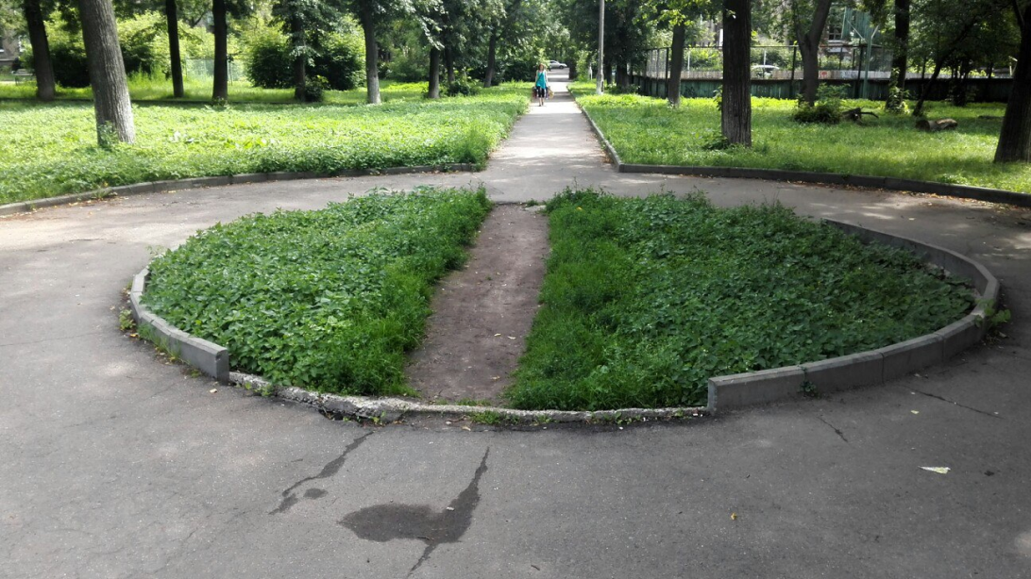
Trust our future selves
Don’t let perfect be the enemy of good
Not all of the application will be (or has to be) perfect
Can always refactor to a better solution
Recognise that insights will come later
For both business and techies
“Knowledge crunching”
Add in desire paths as they start to form
Notes:
Software “engineering” is somewhat suspect as a metaphor
We’re not flying to the moon
Gardening is probably a better metaphor
Grows organically
Needs tending, needs pruning
YAGNI, “last responsible moment”

Slide 42
BUILDING A product, not doing a project
Lease Management, Invoicing
Initially for Italy
Roll-out to France
Integration with General Ledger
Service Charges
Documents/Comms (emailing invoices to tenants)
Capex (Incoming invoices)
France
Over last 5 years

Slide 43
GETTING STARTED – HOW TO DO THIS YOURSELF

Slide 44
Master of your domain

Slide 45

MASTER OF YOUR DOMAIN
We don’t want technology hipsters writing our core domain software
Need a good business analyst
Understanding of / interest in the business domain
Express their analysis in an IDE rather than MS Word
Needs a domain-focused framework to do this
such as Apache Isis

Slide 46
BUILD TRUST with the business
Business needs to know custom software can be delivered
Feedback loops are critical
Working software is the only way to build trust

Slide 47
Case study
Civil engineering company with innovative techniques for working with concrete
won contracts to replace sewers in Zurich
Needs software:
to support project itself
to deliver to end client for “BIM” lifecycle mgmt
Notes:
Domain knowledge
Or the ability to acquire it
Trust
Engage
Create a feedback loop
Deliver something quickly

Slide 48
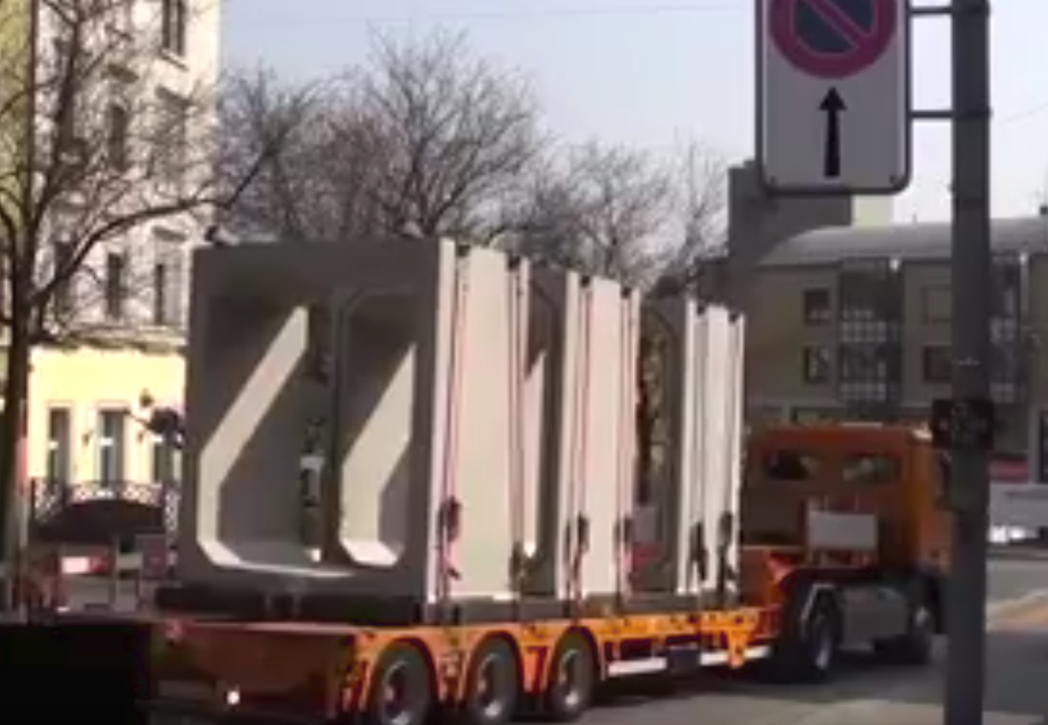
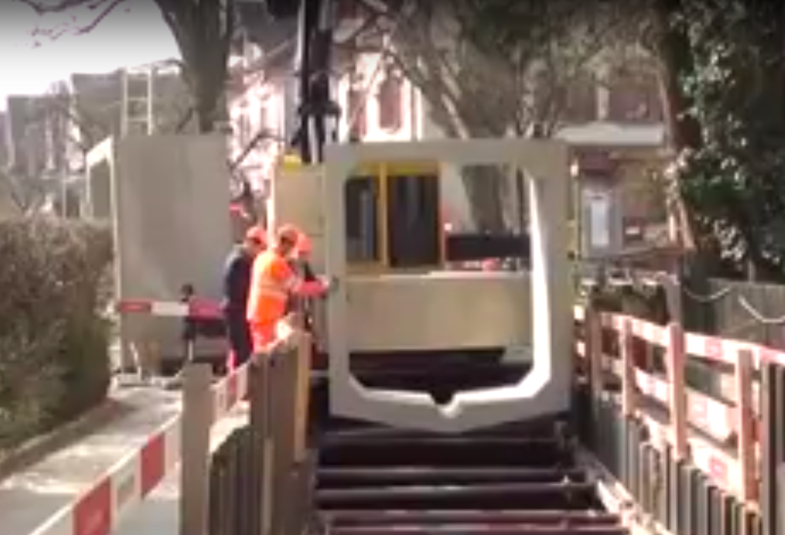
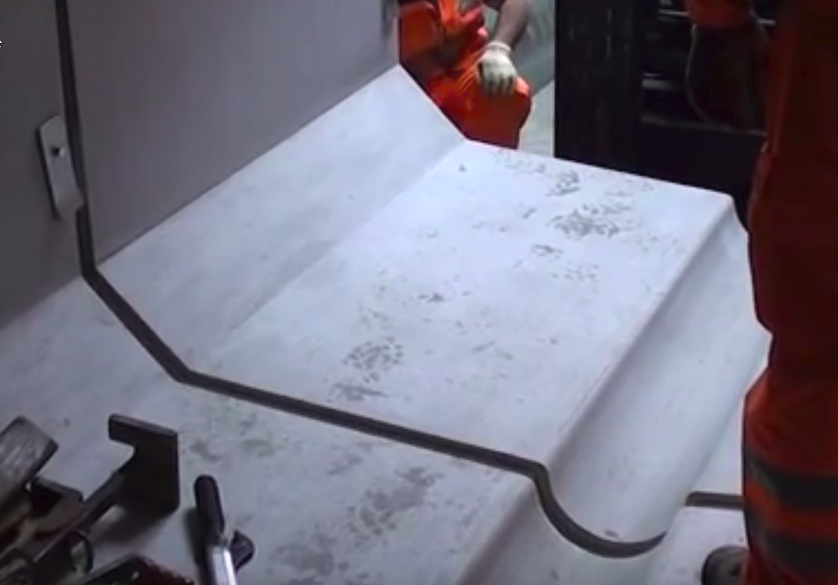

Slide 49
Exploring the domain
In a day we built an app to model part of their domain [video]
insights for domain experts as well as techies
https://github.com/incodehq/colab2-exploration
https://youtu.be/q_ZLUAvV-gM
Notes:
Domain knowledge
Or the ability to acquire it
Trust
Engage
Create a feedback loop
Deliver something quickly

Slide 50
Summing up

Slide 51
OF COURSE There’s a role for packaged software
You’re not going to beat your competitor with a better payroll system
Package software for supporting generic subdomains
Use commodity software for this
Notes:
Wardley maps

Slide 52
BUT … DON’T USE PACKAGED SOFTWARE FOR the CORE DOMAIN
You’ll end up bending your organisation to shape required by the packaged software
The dependencies will be “in the wrong direction”
You’ll have implicit rather than explicit dependencies
You will have vendor lock-in and find it difficult to upgrade
IT should be a profit centre, not a cost centre
Notes:
You’ll end up bending your company to the shape required by the packaged software
rather than the other way around
The dependencies will be backwards
Your custom core domain software should depend on your supporting subdomains
Instead, you’ll have the packaged software requiring custom integrations
You’ll have implicit rather than explicit dependencies
Business process work-arounds, spreadsheets
The gaps will be filled “ad-hoc”, the data quality will be poor
You won’t be able to upgrade
You’ll have vendor lock-in
IT should be a profit center, not a cost center.

Slide 54
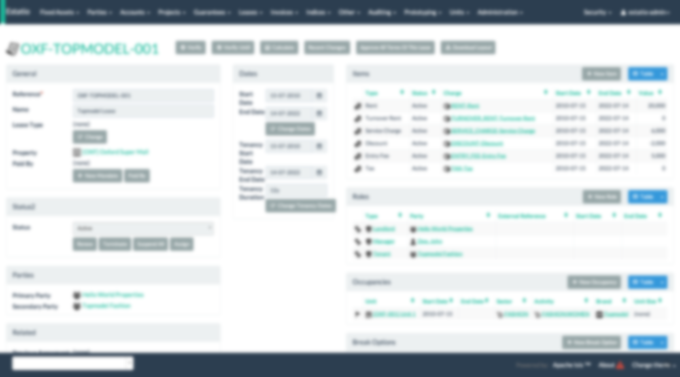
Replaced the market-leading packaged solution in this vertical
Savings
85%
*per external auditor’s estimates

Slide 55

To learn more
http://isis.apache.org
http://platform.incode.org
@dkhaywood
Examples
http://github.com/estatio/estatio
http://github.com/incodehq/contactapp
https://github.com/incodehq/colab2-exploration
Resources
Domain Driven Design, Eric Evans
Naked Objects, Richard Pawson
DDD using NO, Dan Haywood
Event Storming, Alberto Brandolini
Wardley Maps, Simon Wardley
This presentation
http://github.com/danhaywood/imworld2017

Slide 56
APPENDIX - ARCHITECTURE

Slide 57
System

Slide 58
Domain
Presentation
Persistence

Slide 59
Domain
Generic UI
ORM

Slide 60
Domain
Generic UI
ORM

Slide 61
Domain

Slide 62
Domain
REST
Mongo
Web UI
RDBMS
Tests
Neo4J

Slide 63
Domain
REST
Mongo
Web UI
RDBMS
Tests
Neo4J

Slide 64
Appendix - DSP

Slide 65

Department of Social Protection
Administers state benefits for Irish Citizens
Pensions, child benefit and 40+ other schemes
EUR 5bn per year
Development started in 2004
first release 2005
now monthly releases

Slide 66
DSP: Why?
Strategic Agility
Respond to unforeseen changes in business requirements
Operational Agility
Provide clerical officers with greater flexibility to solve customers' problems
Technical Agility
Accommodate changes in technology
Notes:
ECS deadlines (9 months), budget Nov 08 deadlines
Has exhibited agility at strategic, operational and technical levels
New benefit announced in Parliament in Dec 2005
Went live 9 months later, Aug 2006
Similarly in Nov 2008 budget ... first set of requirements live in Feb 2009, next in Apr 2009

Slide 67
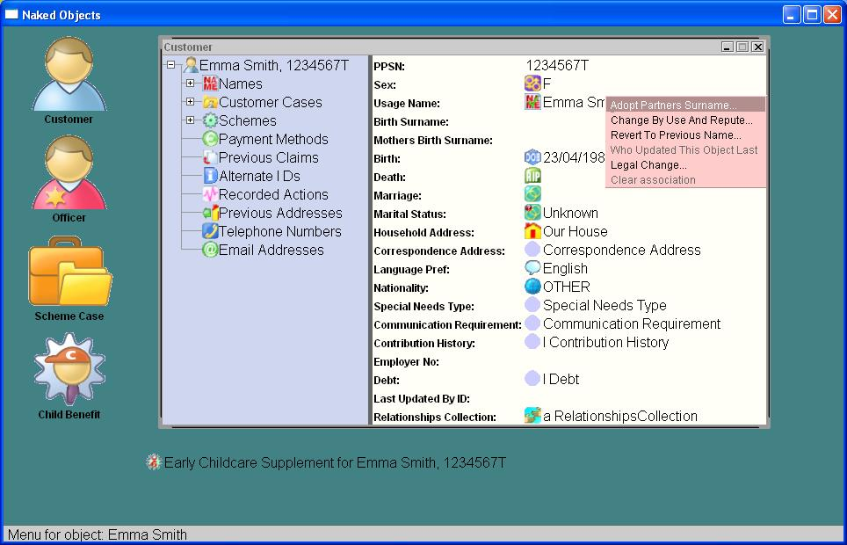
A Desktop metaphor

Slide 68
Appendix – CUSTOM UI’S

Slide 69
A metaphor for the system
treat the user as a problem solver, not a process follower
Notes:
The original metaphor was very powerful

Slide 70
Process Followers
Problem Solvers

Slide 71
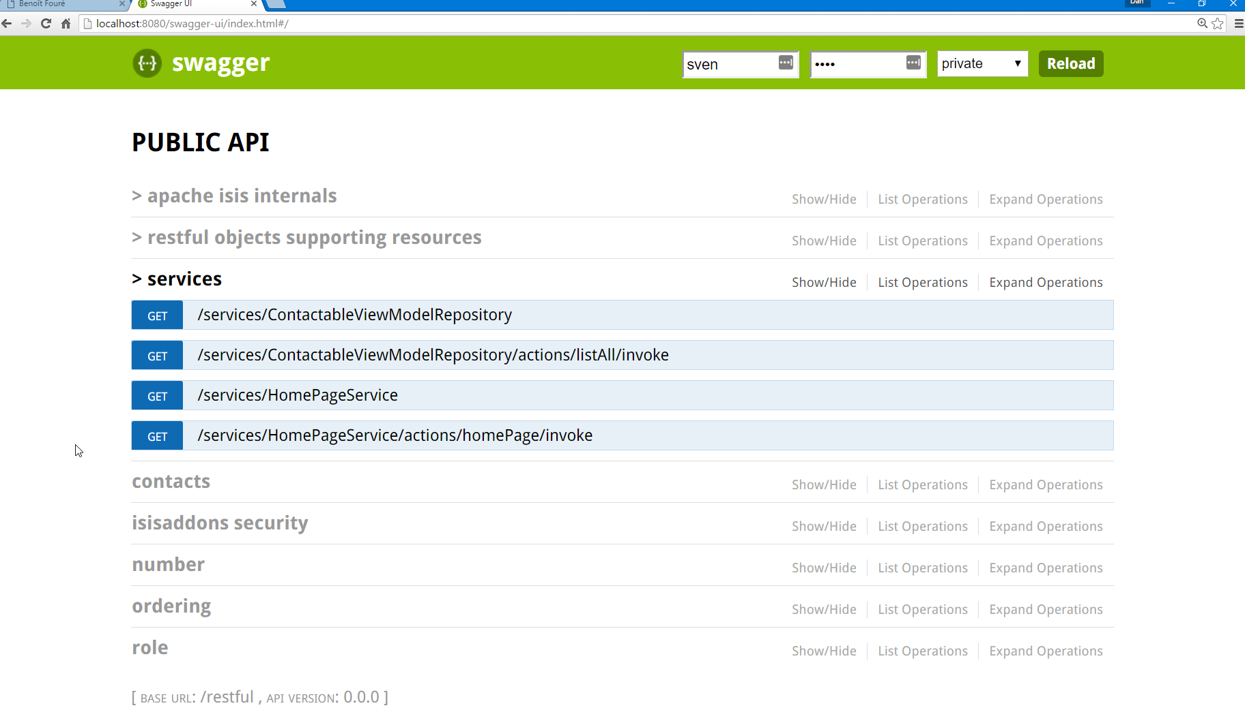
RESTFUL API

Slide 72
CONTACT APP
A mobile app for “emergency contacts” [video]
Custom implementation using Ionic Framework + AngularJS
Leverages Apache Isis REST API
Backend admin UI “for free”
http://github.com/incodehq/contactapp

Slide 73
Appendix – UI IS A FASHION ITEM

Slide 75
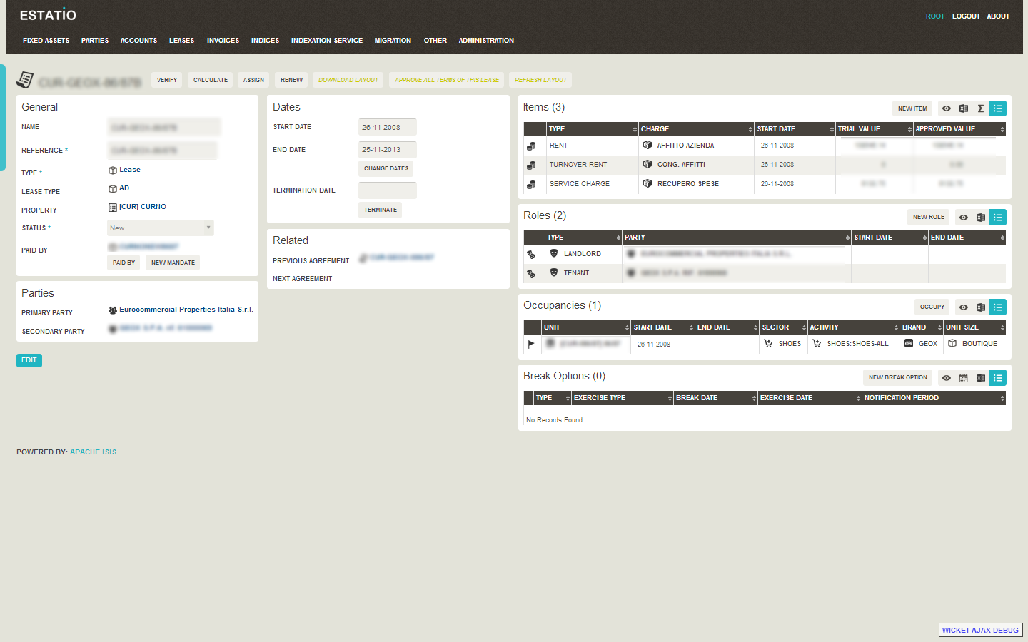

Slide 76
A Desktop UI

Slide 77
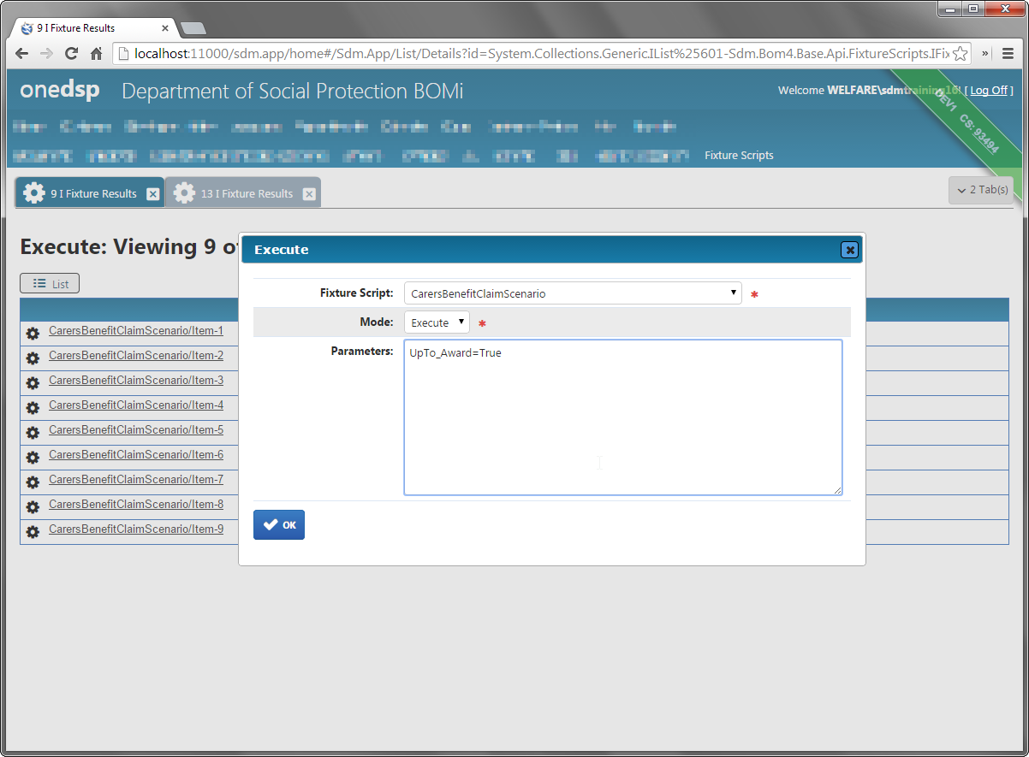
A webapp

Slide 78
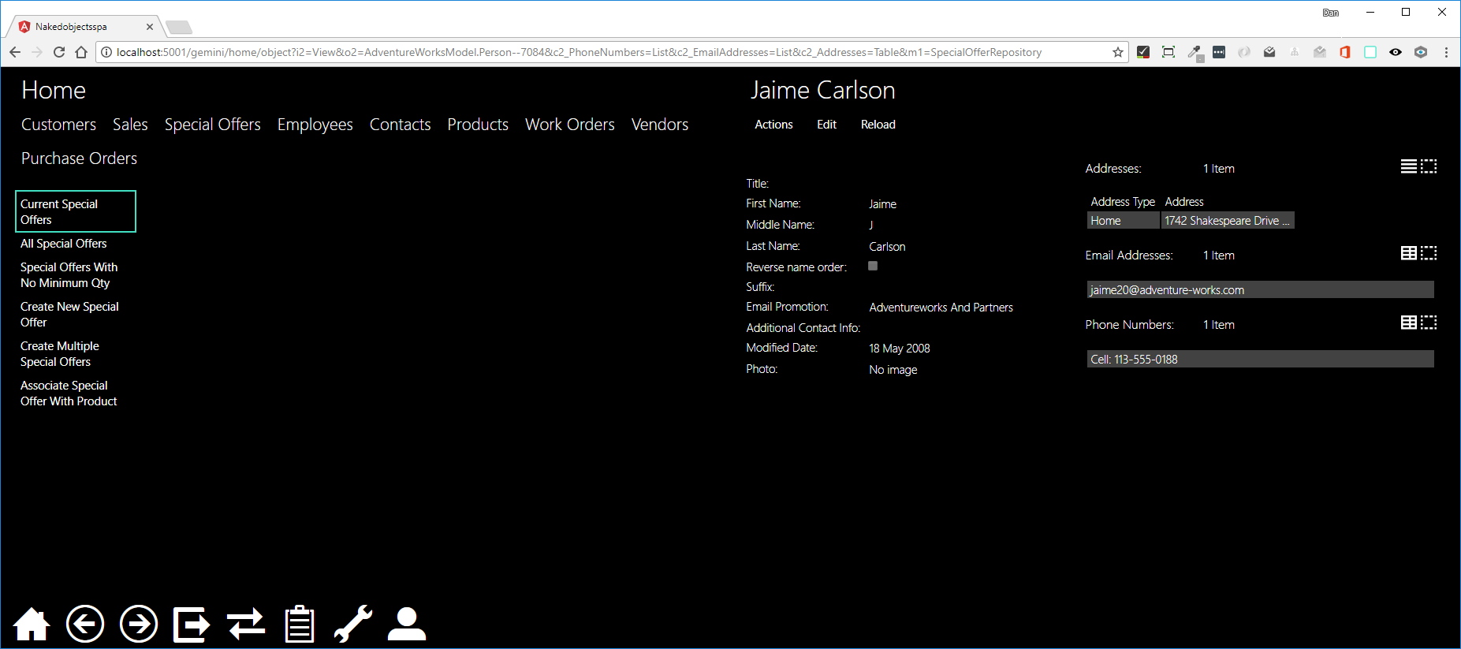
Single page app (angular)

Slide 79
Appendix – OTHER GENERIC VIEWERS

Slide 80
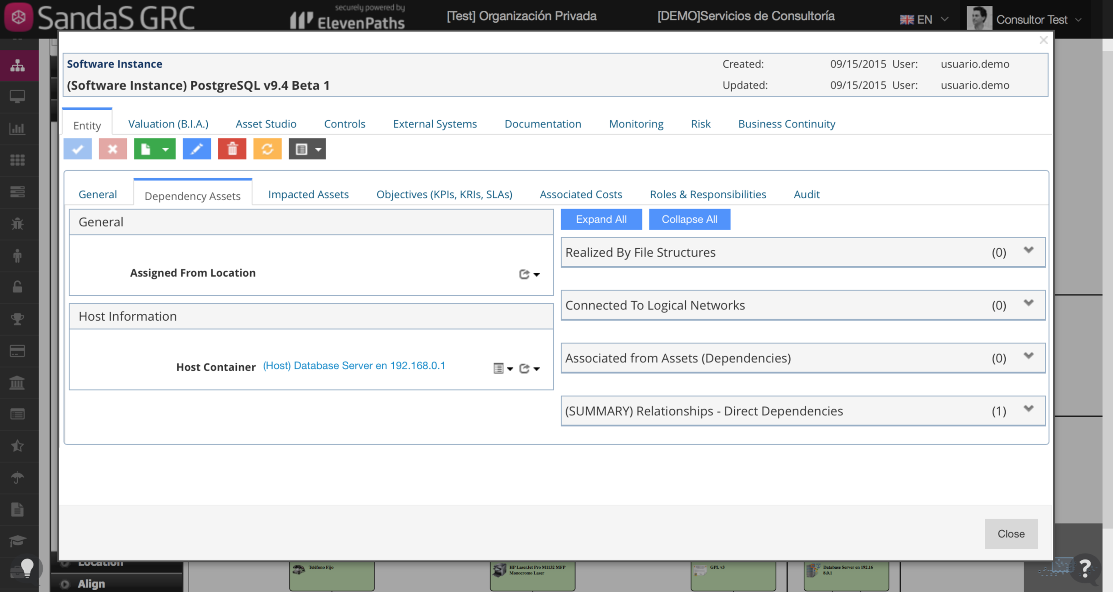
Ges Consultor – proprietary ui for apache isis

Slide 81
Single page app (angular)

Slide 82
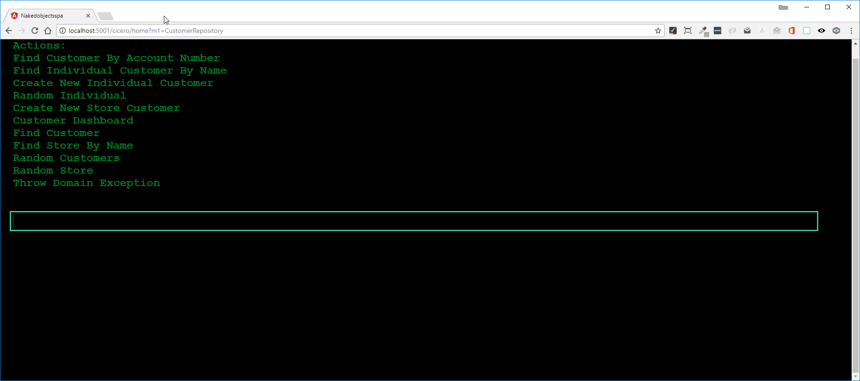
For blind or partiallY sighted users

Slide 83
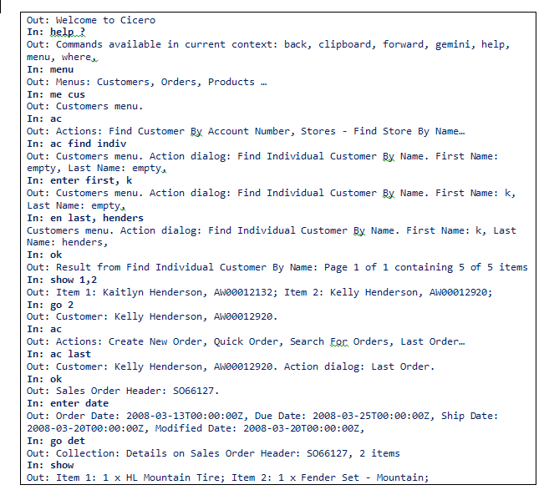
Example transcript

